Slide 1
Quiz
Today’s quiz can be found at bit.ly/15XmAK0
When you’re finished, please download git, if you don’t already have it:
http://git-scm.com/downloads

Slide 2
Intro to Web Development & Design
Lesson 2
The Terminal, Git, and CSS

Slide 3
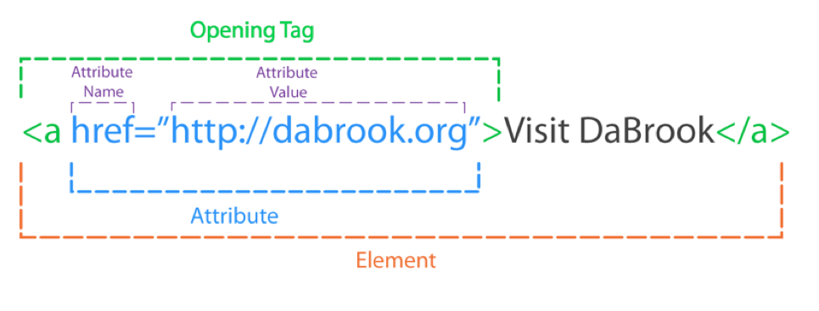
HTML Review
Notes:
Write a simple HTML page w/ the class, this will be used for the basis of the CSS lesson

Slide 4
HTML Comments
<!-- This is a comment -->
Comments are for you to read, not the computer
Use comments so you can come back and understand your code later

Slide 5

https://www.youtube.com/watch?v=Z4MGwdKPds8

Slide 6
The Terminal (aka The Command Line)
A faster way of interacting with your computer
Lets you navigate directories, modify files, run programs, and much more!
A few different types – you’re probably using bash

Slide 7
ls - list directory contents
Prints out a list of files in your directory

Slide 8
cd – change directory
Switch to another directory
Usage:
cd ~/Downloads/nycda-iwdd-lesson-2
cd .. (Go up one directory)
cd - (Go to the previous directory)
Notes:
Explain files on your computer are in a tree structure – open up Finder, show this

Slide 9
pwd – print working directory
Print out the name of the directory you’re currently in

Slide 10
rm - remove
Delete a file
Be careful with this one! It deletes forever – files don’t go to your Trash

Slide 11
Command Line Flags
Many commands have options

Slide 12

Git and Github
Git – version control
Github – a site to put your git repos

Slide 13

CSS Exercise
Style the Onion Article!
Make the main headline dark green.
Use the font family "Georgia" for the main headline and the subheadline.
Center the text of the main headline and the subheadline.
Make the paragraphs have a line height of 19 pixels.
Remove the underline from the links.
Make the "You might also like" label all uppercase.
Bonus: Make an underline appear when you hover over a link.

